Slide 1
Machine Learning Pipelines
Rayid Ghani

Slide 2
Things to remember
Coming up next week:
  Weekly review (before class on Tuesday)
  Transductive Top-k Reading (for Tuesday)
  Wednesday tech session: triage for machine learning
  Due Wednesday: Proposal peer reviews

Slide 3
Finishing Up
Formulation & Baselines

Slide 4
Formulation: Decisions we need to make
What type of analysis are you doing?
What are the relevant entities? How do you identify the cohort?
How do you define the outcome/label that you care about?
How far into the future are you trying to predict?

Slide 5
Structuring the Analytical Formulation
How often is the recommendation/decision being made?
On the 15th of every month, for all households with children under 3 months old, can we identify the 50 highest risk households who are likely to be affected by lead hazards to prioritize for inspection and remediation of lead sources in the following month?
Who/what is included in the cohort?
What is the output?
What outcome are you predicting/estimating?
For what purpose?

Slide 6
Baselines
What is the appropriate comparison
for your ML model?

Slide 7
Baseline Options
Common Sense
What they do today
What they could do today easily (without any or very simple ML involved)
Prior/Base Rate
  What expected value would you get if you just choose at random (based on the data distribution)?
Good baselines should provide an ordering to sort the entities
  Heuristic rules (or shallow decision trees) might reflect current practice, but can yield a small number of unique scores with lots of ties

Slide 8
For the Netflix example, what would be a reasonable baseline method that doesn't require using any ML?
sli.do #94889
sli.do/94889

Slide 9
Baseline Considerations
How much better than baselines does our system need to be in order to deploy?
Important to compare performance against the base rate/prior, but this prior rarely represents a “common sense” baseline
Good baselines should provide an ordering to sort the entities
  Heuristic rules (or shallow decision trees) might reflect current practice, but can yield a small number of unique scores with lots of ties
In many real-world problems, a good baseline can be difficult to beat

Slide 10
Baseline Examples

Slide 11
Machine Learning
Pipelines

Slide 12
Scope
Data
Exploration
Modeling
Get Data
Store Data
Link Data
Rows
Features
Labels
Model Selection
Train-Test Splits
Performance Metrics
Model Interpretation
Entities
temporal
Spatial
…
Models
Dealing with Bias and Fairness
Field Trial Design
Deployment
Monitoring
Goals, Actions, Data, Analysis, Ethics

Slide 13
Things we will cover
What is an ML Pipeline?
Why should we build ML pipelines?
What components should it have?
Best Practices
Good Examples

Slide 14
What is an ML Pipeline?
Supports end-to-end workflow for an ML project/system
Modular
Reconfigurable

Slide 15
Why build a pipeline?
Reusable across projects
Test new ideas, components, hypothesis easily
Reduce bugs/errors
Allows reproducibility of analysis and results

Slide 16
What makes a pipeline?
Inputs
Components
(Intermediate and final) outputs

Slide 17
Pipeline Flow & Components

Slide 18
Pipeline Flow
Get Data
Integrate Data
Prep for Modeling
Process Data
Explore Data
label generation
train-test sets
feature generation
matrix generation
Modeling
train, test, generate metrics
Model Selection
(Field) Evaluation
Deployment
Maintenance/Update

Slide 19
What components does a pipeline have?
Read/Load Data (from csv, db, api)
Integrate Data (dedupe, link)
Process Data (cleaning)
Explore Data (descriptive stats, correlations, outliers, over time, clustering)
Modeling Prep
  Create training and test sets
  Missing values (fill/impute, create dummy)
  Transformations (scale/normalize, log, square, root)
  Feature Generation
  Label Generation
  Define metric(s)
Modeling
  Build model(s) on training sets
  Apply model(s) on test sets
  Calculate metric(s)
Model Selection
Field Trial
Deploy
Maintain

Slide 20
Things to keep in mind about each component
Processing
  Modular, extensible functions
Inputs
  Data structures/format?
  Parameters/Configuration?
Outputs
  Data structures/format?
  Store to disk/db?

Slide 21
Components: Data Acquisition & Integration
Get Data
  API, CSV, Database
Store Data
  Database
Integrate Data
  Record Linkage

Slide 22
Components: Explore and Prepare data
Data Exploration
  Distributions
  Missing Values
  Correlations
  Other Patterns
Pre-Processing
  Leakage
  Deal with Missing values
  Scaling
  Data errors

Slide 23
Components: Feature Creation
Data comes with fields or columns (if it’s even structured), not features
Common Features
  Discretization
  Transformations
  Interactions/Conjunctions
  Disaggregation
  Aggregations
    Temporal
    Spatial
How are you handling imputation of missing values?

Slide 24
Components: Method Selection
Select pool of methods applicable for task
For loop over a large number of methods
  For loop over parameters

Slide 25
Components: Validation
Using historical data
  Methodology
  Metric
Field Experiment
  Methodology
  Metric

Slide 26
Deployment
Model monitoring
Re-training
  How often?
  Re-select methods?
Scoring

Slide 27
What types of variations do you want to test using your pipeline?
Different models
Model parameters
Different Labels/Outcomes
Different Deployment Settings
Different Feature (Groups)
Different Metrics

Slide 28
Best Practices
Draw a diagram of the pipeline:
  What function runs each step? What are the inputs? What are the outputs?
Config files (yaml, json, py)
Make each step modular and extensible so it can easily be re-used
Build a simple, end-to-end version first, then add more functionality
Think about how you’ll store outputs:
  Store models as pickles
  Store predictions in databases
  Store evaluation metrics in databases
  Sample results schema

Slide 29
Config file examples

Slide 30
Get Started by building a simple pipeline
Build a simple, modular, extensible, machine learning pipeline with functions to do the following:
  ETL and exploration
    Load Data
    Explore data
    Pre-process data
  Cohort Creation
    Create rows
    Create labels for each row
    Create one feature
  Train Test Set Creation
    Generate one training set
    Generate one validation set
  Modeling
    Build 1 classifier on training set
    Run the 1 classifier on the validation set
    Calculate one metric

Slide 31
Timesplitter
  Input: start time, end time, update time, prediction time
  Output: pairs of <train start time, train end time, test start time, test end time>
CohortCreator
  Input: timesplitter output, cohort definition,[entity_ids, as of date]
  Output: cohort matrix <entity_id, as_of_date>
LabelCreator
  Input: pairs <entity_id, as_of_date>, label definition
  Output: matrix <entity_id, as_of_date, label>
FeatureCreator
  Input: pairs <entity_id, as_of_date>, feature definition(s)
  Output: matrix <entity_id, as_of_date, feature(s)>
ModelTrainer
  Input: model definition, matrix, feature columns, label column
  Output: model object (stored), model definition
Scorer
  Input: model object, matrix, feature columns
  prediction scores
Evaluator
  Prediction scores, label column, metric(s)

Slide 32
Progression
Determine Input/outputs for each component
Example of code for each component
python file that imports each component and builds a pipeline for 1 train test set, 1 model, 1 metric, etc.
Loop over additional variations
Move parameters from python file to external config file
SQL and python

Slide 33
Things to remember
Coming up next week:
  Weekly review (before class on Tuesday)
  Transductive Top-k Reading (for Tuesday)
  Wednesday tech session: triage for machine learning
  Due Wednesday: Proposal peer reviews

Slide 34
Appendix:
Slides from Previous Tech Session

Slide 35
Train Examples
Labels
Validate Examples
Labels

Slide 36
Features Data
Train Examples
Labels
Validate Examples
Labels

Slide 37
Time Splitter

Slide 38
Time Splitter
Cohort Creator
Database

Slide 39
Time Splitter
Cohort Creator
Label Creator
Database

Slide 40
Time Splitter
Cohort Creator
Label Creator
Feature Creator
Database

Slide 41
Time Splitter
Cohort Creator
Label Creator
Feature Creator
Matrix Creator
Database

Slide 42
Time Splitter
Cohort Creator
Label Creator
Feature Creator
Matrix Creator
Model Trainer
Database

Slide 43
Time Splitter
Cohort Creator
Label Creator
Feature Creator
Matrix Creator
Model Trainer
Database
Score Predictor

Slide 44
Time Splitter
Cohort Creator
Label Creator
Feature Creator
Matrix Creator
Model Trainer
Database
Score Predictor
Model Evaluator

Slide 45
config.yaml
Pipeline Runner
Orchestration + Config Parameters
Time Splitter
Cohort Creator
Label Creator
Feature Creator
Matrix Creator
Model Trainer
Database
Score Predictor
Model Evaluator

Slide 46
config.yaml
Pipeline Runner
Orchestration + Config Parameters
Time Splitter
Cohort Creator
Label Creator
Feature Creator
Matrix Creator
Python + SQL
Model Trainer
Database
Python
Score Predictor
Model Evaluator

Slide 47
config.yaml
Pipeline Runner
Orchestration + Config Parameters
Time Splitter
Cohort Creator
Label Creator
Feature Creator
Matrix Creator
Model Trainer
Database
Score Predictor
Model Evaluator

Slide 48
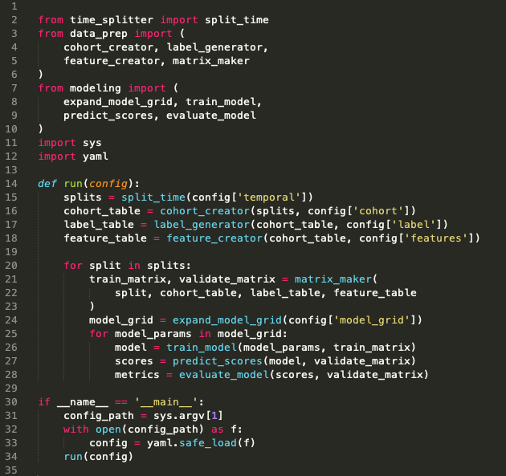
Pipeline Runner

Slide 49
config.yaml
Pipeline Runner
Orchestration + Config Parameters
Time Splitter
Cohort Creator
Label Creator
Feature Creator
Matrix Creator
Model Trainer
Database
Score Predictor
Model Evaluator

Slide 50
Time Splitter
Features Data
Train Examples
Labels
Validate Examples
Labels

Slide 51
Time Splitter
Features Data
Train Examples
Labels
Validate Examples
Labels
Features Data
Train Examples
Labels
Validate Examples
Labels
Features Data
Train Examples
Labels
Validate Examples
Labels
Features Data
Train Examples
Labels
Validate Examples
Labels
•
•
•

Slide 52
Time Splitter
INPUTS
Temporal Parameters:
Beginning of time
End of time
Label Window
Example History
Update Frequency
OUTPUTS
Paired train/validate sets of dates:
[
(train_start_1, train_end_1),
(test_start_1, test_end_1)
],
[
(train_start_2, train_end_2),
(test_start_2, test_end_2)
], …
Note: Not splits of the data!
(you still need the full history for features)

Slide 53
config.yaml
Pipeline Runner
Orchestration + Config Parameters
Time Splitter
Cohort Creator
Label Creator
Feature Creator
Matrix Creator
Model Trainer
Database
Score Predictor
Model Evaluator

Slide 54
Cohort Creator
INPUTS
Train/validate split dates
Cohort logic
(e.g., SQL snippet in config)
Cleaned data
OUTPUTS
Sets of entities at a given time that will define rows in training/validation matrices:
entity_id, time

Slide 55
config.yaml
Pipeline Runner
Orchestration + Config Parameters
Time Splitter
Cohort Creator
Label Creator
Feature Creator
Matrix Creator
Model Trainer
Database
Score Predictor
Model Evaluator

Slide 56
Label Creator
INPUTS
Train/validate split dates
Cohort ids+dates
Label definition logic + window
(e.g., via SQL snippet in config)
Cleaned data
OUTPUTS
Label values for each entity/date pair in the cohort:
entity_id, date, label(s)

Slide 57
config.yaml
Pipeline Runner
Orchestration + Config Parameters
Time Splitter
Cohort Creator
Label Creator
Feature Creator
Matrix Creator
Model Trainer
Database
Score Predictor
Model Evaluator

Slide 58
Feature Creator
INPUTS
Train/validate split dates
Cohort ids+dates
Feature definition logic + windows
(e.g., via SQL snippets in config)
Cleaned data
OUTPUTS
Feature values for each entity/date pair in the cohort:
entity_id, date, feature cols
Note: often useful to group related features together for testing, etc.

Slide 59
config.yaml
Pipeline Runner
Orchestration + Config Parameters
Time Splitter
Cohort Creator
Label Creator
Feature Creator
Matrix Creator
Model Trainer
Database
Score Predictor
Model Evaluator

Slide 60
Matrix Creator
INPUTS
Train/validate split dates
Cohort ids+dates
Label values
Feature values
OUTPUTS
Pairs of train + validation matrices
(np.array, pd.DataFrame, scipy.csr_matrix, etc.)
Note: all this needs to do at this point is join the cohorts, labels, and features together for each set of dates

Slide 61
config.yaml
Pipeline Runner
Orchestration + Config Parameters
Time Splitter
Cohort Creator
Label Creator
Feature Creator
Matrix Creator
Model Trainer
Database
Score Predictor
Model Evaluator

Slide 62
Model Trainer
INPUTS
Train Matrix
(and associated temporal metadata)
Model type + parameters
(from config)
OUTPUTS
Trained model object
(downstream + to disk)
Model metadata to database
model type, hyperparameters,
training dates, model_id
Note: Helpful to keep track of sets of models with the same parameters (type, features, hyperparameters, label definition, etc) trained on different time splits

Slide 63
config.yaml
Pipeline Runner
Orchestration + Config Parameters
Time Splitter
Cohort Creator
Label Creator
Feature Creator
Matrix Creator
Model Trainer
Database
Score Predictor
Model Evaluator

Slide 64
Score Predictor
INPUTS
Validation Matrix
(and associated temporal metadata)
Trained model object
(and associated model_id)
OUTPUTS
Predicted scores
Note: Helpful to persist to the database for downstream analyses, but can get large, so be sure to index (and may want to make storage optional, especially during initial debugging)

Slide 65
config.yaml
Pipeline Runner
Orchestration + Config Parameters
Time Splitter
Cohort Creator
Label Creator
Feature Creator
Matrix Creator
Model Trainer
Database
Score Predictor
Model Evaluator

Slide 66
Model Evaluator
INPUTS
Validation Matrix (Actual Labels)
(and associated temporal metadata)
Predicted Scores
Metric definition(s)
(from config)
OUTPUTS
Model performance on metrics:
model_id, validation_date, metric,
parameter, value
examples:
108, 2015-03-14, precision, 500_abs, 0.62
108, 2015-03-14, recall, 15_pct, 0.25
108, 2015-03-14, recall, 0.8_thresh, 0.42
Note: Helpful to persist to the database for downstream analyses

Slide 67
config.yaml
Pipeline Runner
Orchestration + Config Parameters
Time Splitter
Cohort Creator
Label Creator
Feature Creator
Matrix Creator
Model Trainer
Database
Score Predictor
Model Evaluator

Slide 68
Database
raw data
cleaned data

Slide 69
Database
raw data
cleaned data
model_prep schema
cohort
labels
features_
demo
features_
history
. . .
id, time
id, time, label(s)
id, time, feat1,…
id, time, feat1,…

Slide 70
Database
raw data
cleaned data
model_prep schema
cohort
labels
features_
demo
features_
history
. . .
id, time
id, time, label(s)
id, time, feat1,…
id, time, feat1,…
results schema
model_sets
models
predictions
evaluations
model_set_id,
type, params
model_set_id,
model_id, time
model_id, id,
time, score, label
model_id, time,
metric, value

Slide 71
config.yaml
Pipeline Runner
Orchestration + Config Parameters
Time Splitter
Cohort Creator
Label Creator
Feature Creator
Matrix Creator
Model Trainer
Database
Score Predictor
Model Evaluator

Slide 72
config.yaml
Pipeline Runner
Orchestration + Config Parameters
Time Splitter
Cohort Creator
Label Creator
Feature Creator
Matrix Creator
All the project-
specific details!
Model Trainer
Database
Score Predictor
Model Evaluator

Slide 73
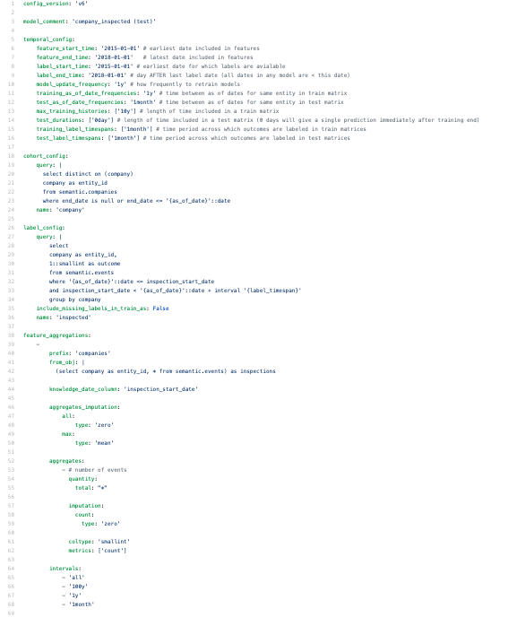
config.yaml
https://github.com/dssg/direccion_trabajo_inspections/blob/master/experiments/test.yaml

